Slide 1
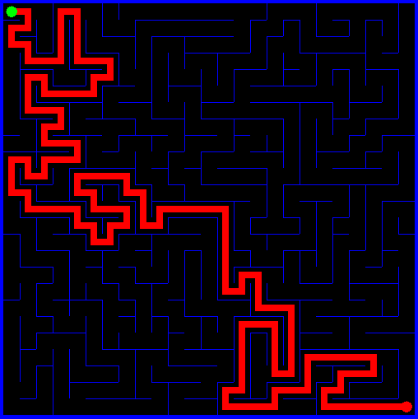
Algorithms and Data Structures
Graph Algorithms
DFS/BFS Revisited
Topological Sort
Kosaraju’s Algorithm
Bellman-Ford Algorithm

Slide 2
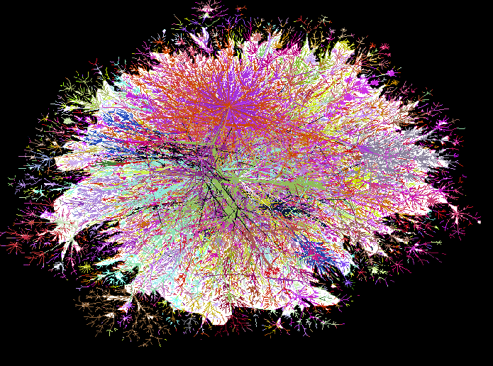
Internet Network

Slide 3
Social Networks

Slide 4
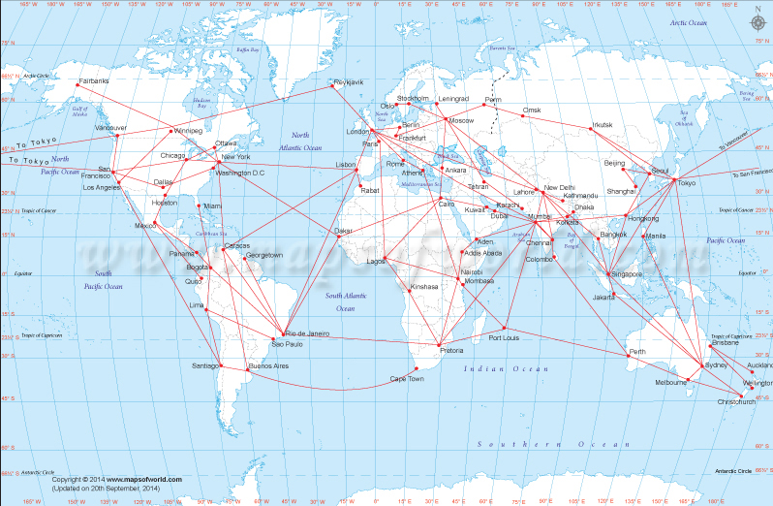
Air Routes

Slide 5
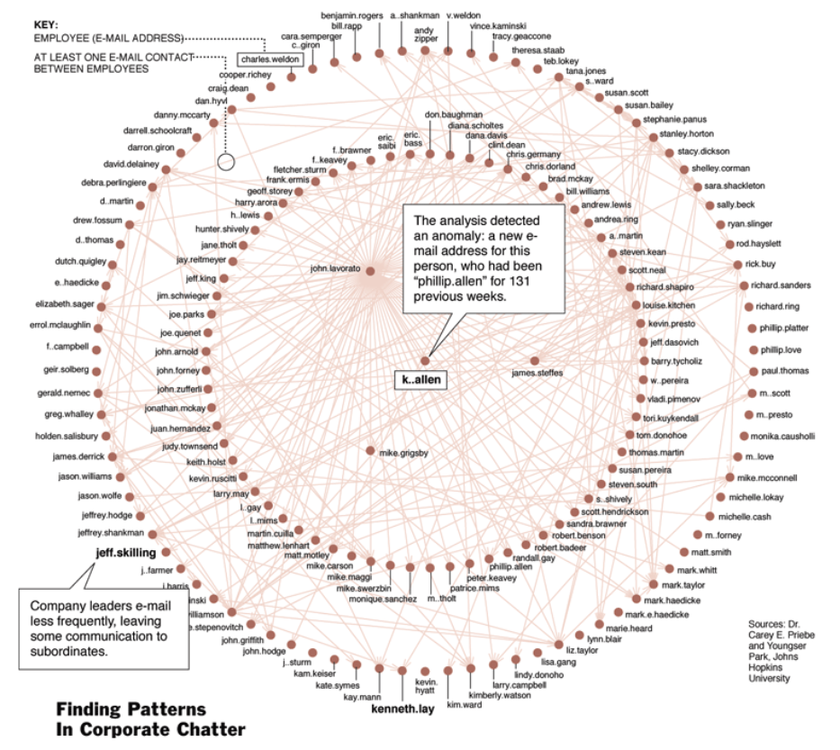
Enron Emails

Slide 6
Algorithms and Data Structures
A graph is a connected group of vertices and edges.
A directed cycle is a directed path (with at least one edge) whose first and last vertices are the same. A simple cycle is a cycle with no repeated edges or vertices (except the requisite repetition of the first and last vertices).

Slide 7
Graphs/Directional
A
How do you write an algorithm to check for a path between vertices / nodes?
C
B
D
E

Slide 8
Digraph – Strongly Connected
A
C
B
D
E
Notes:
A digraph is strongly connected if there is a directed path from every vertex to every other vertex.
Think six degrees of separation or the Kevin Bacon number.
I.e. A strongly connected digraph is a directed graph in which it is possible to reach any node starting from any other node by traversing edges in the direction(s) in which they point.

Slide 9
Digraph – And It’s Strong Components
0
6
7
8
2
9
10
1
3
11
4
12
5

Slide 10
DAG-Directed Acyclic Graph
0
6
7
8
2
9
10
1
3
4
12
11
5
Notes:
A DAG is a finite directed graph with no directed cycles. That is, it consists of finitely many vertices and edges, with each edge directed from one vertex to another, such that there is no way to start at any vertex v and follow a consistently-directed sequence of edges that eventually loops back to v again

Slide 11
DFS Revisited
DFS: Algorithm
DFS(Digraph g, int v)
mark v as visited
for each of v’s neighbors, n, not in visited set:
DFS(g, n)

Slide 12
Topological Sort
Given a directed acyclic graph, put the vertices in order such that all its directed edges point from a vertex earlier in the order to a vertex later in the order.

Slide 13
Topological Sort
undershorts
socks
pants
shoes
shirt
belt
watch
tie
jacket
Notes:
Diagram from Cormen

Slide 14
DAG-Directed Acyclic Graph
0
6
7
8
2
9
10
1
3
4
12
11
5

Slide 15
Topological Sort
8
7
2
3
0
6
9
10
11
12
1
5
4
Any linear ordering where the arrows go to the right is a valid topological order.
Notes:
This is just one topological sort from this graph. There are several others.

Slide 16
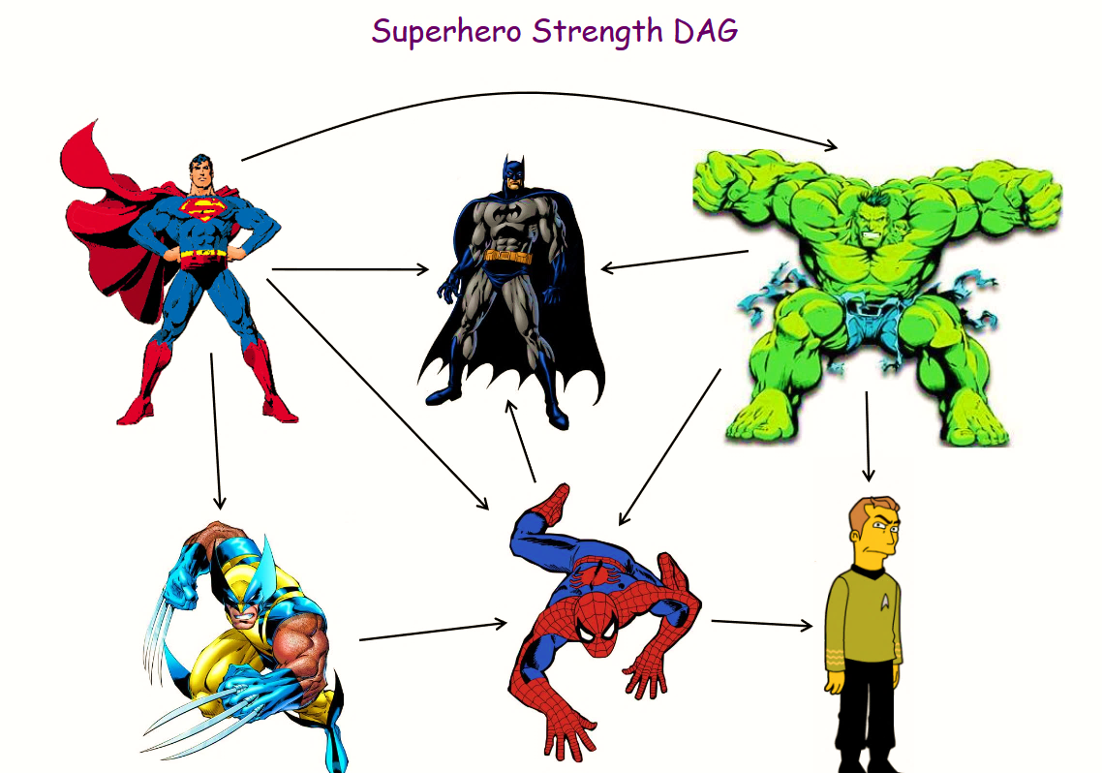
Topological Sort

Slide 17
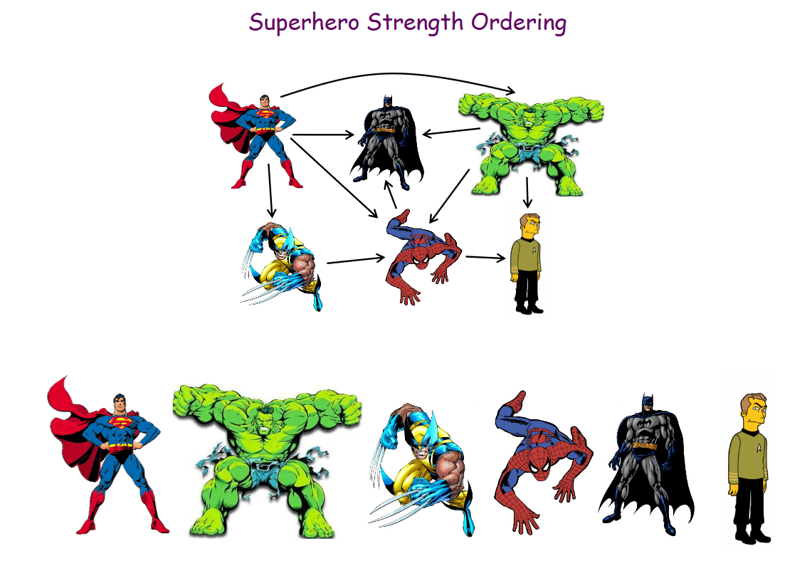
Topological Sort

Slide 18
DAG-Directed Acyclic Graph
0
8
6
SET
LL
2
7
1
9
10
3
4
11
12
5

Slide 19
Topological Sort
A reverse post order of a DAG will provide a topological order.
Algorithm
loop thru all vertices
if vertex hasn’t been visited call DFS(g, v)
At the end of DFS(after all recursive calls) be sure to add the vertex to the front of a linked list or to a stack.

Slide 20
Digraph – SCC
0
6
7
8
2
9
10
1
3
11
4
12
5

Slide 21
Kosaraju’s Algorithm
1) Use same reverse post order algorithm from topological sort. 2) Transpose the graph(reverse arrows). 3) Loop thru list acquired from part 1 and call DFS on each vertex not visited yet. Find all reachable nodes from that vertex and group them as a SCC.
Notes:
Kosaraju's algorithm (also known as the Kosaraju–Sharir algorithm) is a linear time algorithm to find the strongly connected components of a directed graph. Aho, Hopcroft and Ullman credit it to an unpublished paper from 1978 by S. Rao Kosaraju. The same algorithm was independently discovered by Micha Sharir and published by him in 1981. It makes use of the fact that the transpose graph (the same graph with the direction of every edge reversed) has exactly the same strongly connected components as the original graph. – Wikipedia
An alternative algorithm credited to Robert Tarjan is also done in linear time and only has one call to DFS.

Slide 22
[7, 8, 6, 9, 11, 10, 12, 0, 5, 4, 2, 3, 1]
[7, 8] [6] [9, 10, 11, 12] [0, 2, 3, 4, 5] [1]
0
6
7
8
2
9
10
1
3
12
4
11
5

Slide 23
Bellman-Ford
Algorithm for single source shortest paths
More general than Dijkstra’s algorithm:
Edge-weights can be negative
Detects the existence of negative-weight cycle(s) reachable from s.

Slide 24
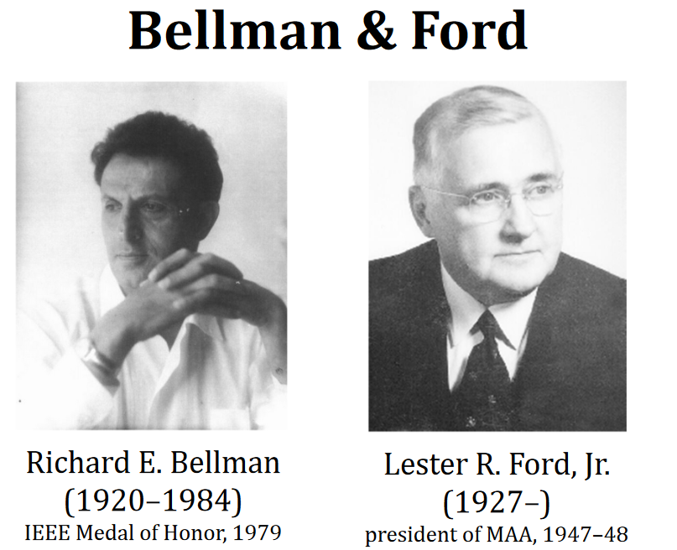
Bellman-Ford

Slide 25
Bellman-Ford
bellmanFordAlgorithm(G,s):
for v in V:
v.d = ∞
s.d = 0
for i from 1 to |V| -1:
for (u, v) in E:
relax(u,v)
relax(u,v):
if v.d > u.d + w(u,v):
v.d = u.d + w(u,v)
v.parent = u

Slide 26
Bellman-Ford
u
v
5
∞
∞
–2
6
–3
8
z
0
7
–4
7
2
∞
∞
9
x
y

Slide 27
Bellman-Ford
u
v
5
6
∞
–2
6
–3
8
z
0
7
–4
7
2
7
∞
9
x
y

Slide 28
Bellman-Ford
u
v
5
6
4
–2
6
–3
8
z
0
7
–4
7
2
7
2
9
x
y

Slide 29
Bellman-Ford
u
v
5
2
4
–2
6
–3
8
z
0
7
–4
7
2
7
2
9
x
y

Slide 30
Bellman-Ford
u
v
5
2
4
–2
6
–3
8
z
0
7
–4
7
2
7
-2
9
x
y

Slide 31

Bellman-Ford
Note: This is essentially dynamic programming.
i
z u v x y
1 2 3 4 5
0 0 ∞ ∞ ∞ ∞
1 0 6 ∞ 7 ∞
2 0 6 4 7 2
3 0 2 4 7 2
4 0 2 4 7 –2
j

Slide 32
Big O
Depth First Search
O(n + m) or O(v + e)
Topological Sort
O(n + m)
Kosaraju’s Algorithm
O(n + m)
Bellman-Ford Algorithm
O(n * m)

Slide 33

Words of Wisdom
Don’t fall behind.
Visualize and comprehend the problem before writing any code.
Stress test your code thoroughly.
Be patient and take a break
if you’ve been stuck for a while.
Break out the rubber duck.

